Slide 1
E-commerce Product Review Analysis Assignment
BY: AMBATI HARSHITHA

Slide 2
Introduction and Overview of the Project
This assignment or project goal is to gain insights into customer reviews and ratings for electronics products on Amazon, identifying trends, popular products, and potential areas for improvement.

Slide 3
Methodology Summary
1. Data Loading & Cleaning
Dataset (data1.csv) is loaded using pandas.
Missing values are identified and handled:
Dropped: Columns like reviews.didPurchase and reviews.id (due to excessive missing values).
Imputed:
reviews.doRecommend → Missing values replaced with False.
reviews.numHelpful → Missing values replaced with 0.
Duplicate rows are removed to ensure data integrity.

Slide 4
Data Preprocessing
Date Handling:
Columns (dateAdded, dateUpdated, reviews.date, reviews.dateSeen) are converted to datetime format.Text Cleaning & NLP Processing:
to lowercase.
Removed HTML tags & special characters.
Tokenized into words.
Stopwords removed.
Reviews ned text is stored in a new column cleaned_reviews.

Slide 5
Review Trend Analysis
Temporal Analysis:
A new column (Month-Year) is created from dateAdded to analyze reviews over time.
Review Distribution Calculation:
The number of reviews per month is calculated and divided by the total number of unique products to get a review rate.
Visualization:
Trends in review rates are plotted using matplotlib.
Individual product review rates are also analyzed separately.
Feature Engineering:
TF-IDF Vectorization:
The Tfidf Vectorizer converts reviews into numerical vectors using the top 5000 most important words.
The transformed features are merged with the dataset.

Slide 6
Requirements and Libraries Needed
Core Libraries
pandas → For data manipulation and handling missing values.
numpy → Used indirectly (not explicitly mentioned, but might be used for numerical operations).
matplotlib.pyplot → For visualization (plotting trends over time).
2. Machine Learning & NLP Libraries
sklearn.feature_extraction.text.TfidfVectorizer → For text vectorization.
sklearn.model_selection.train_test_split → To split data into training and testing sets.
sklearn.ensemble.RandomForestClassifier → For sentiment classification.
sklearn.metrics → For accuracy and classification report.
3. NLP-Specific Libraries
nltk.tokenize.word_tokenize → Tokenization.
nltk.corpus.stopwords → Removing stopwords.
nltk.stem.WordNetLemmatizer → Lemmatization.
re → Regular expressions for text preprocessing.
nltk.download("punkt", "stopwords", "wordnet") → Download required NLP resources.

Slide 7
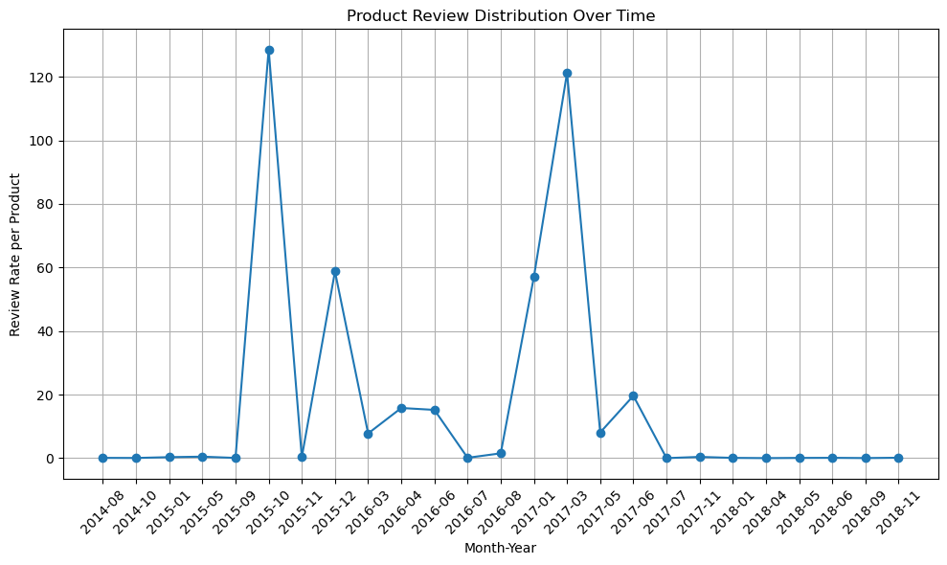
Graphical Representation of Product Analysis

Slide 8
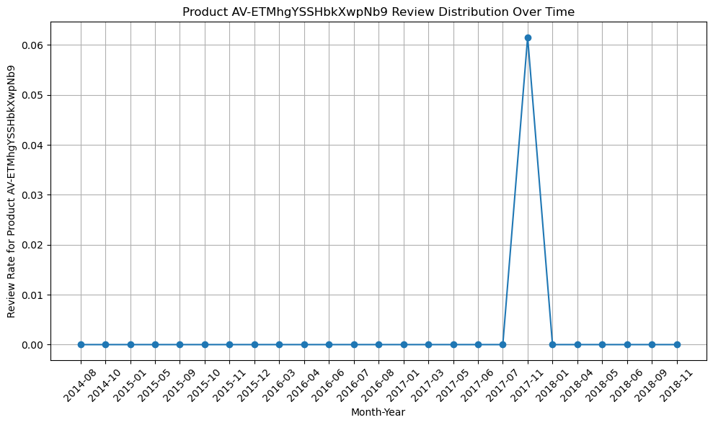

Slide 9
Potential Insights
Seasonal Trends: The spikes in October and December might correlate with holiday shopping periods, suggesting increased customer engagement during these times.
Product Launch or Promotion: The peak in March 2017 could indicate a significant product launch, promotion, or a major update that drove more customers to leave reviews.
Customer Feedback Fluctuations: The varying review rates highlight periods of higher and lower customer feedback, which could be useful for understanding customer satisfaction trends or marketing effectiveness.

